Slide 1

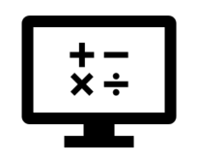
Fundamentals
Where do I find MATLAB? Here!
Do I have to have MATLAB installed on my computer right now? No, you can use MATLAB Online!

Slide 2

Table of Contents
What we've covered this week in Part 1 What is MATLAB? How to access MATLAB The MATLAB Desktop MATLAB Cheat Sheet Obtaining Help in MATLAB Basic Debugging in MATLAB What we've learnt this week in Part 2
MATLAB Live Script

Slide 3
What we've covered this week in Part 1
This week in Part 1 we learnt about:
What programming is

Slide 4

What is MATLAB?
What is MATLAB? Video
MATLAB is a programming and numeric computing environment used by millions of engineers and scientists to analyse data, develop algorithms, and create models. MATLAB provides professionally developed toolboxes for signal and image processing, control systems, wireless communications, computational finance, robotics, deep learning, and AI and more.
MATLAB combines a desktop environment tuned for iterative analysis and design processes with a high-level programming language that expresses matrix and array mathematics directly. It includes the Live Editor for creating scripts that combine code, output, and formatted text in an executable notebook. Prebuilt apps allow you to interactively perform iterative tasks. You can then automatically generate the corresponding MATLAB code to reproduce your work and add it to your script with a push of a button.

Slide 5
How to access MATLAB
See Getting Started With MATLAB for instructions on how to get MATLAB.

Slide 6
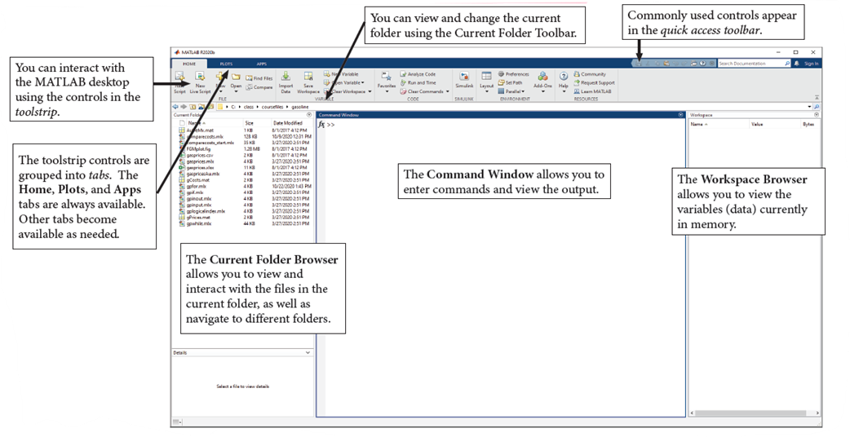
The MATLAB Desktop
By default, MATLAB displays a desktop interface divided into three core components: the Command Window, the Workspace Browser, and the Current Folder Browser. Other components and windows are automatically opened as necessary.

Slide 7
MATLAB Cheat Sheet
See the MATLAB Cheat Sheet for a quick reference to some basic MATLAB functions.

Slide 8
Obtaining Help in MATLAB
MATLAB help and documentation can show you
The various ways to call a function
The algorithm implemented by a function
Examples of how to use a function
Links to related functions
Tutorials and background information

Slide 9
Obtaining Help in MATLAB
To display documentation on a particular function, type the word "doc" and the name of the function:
doc plot
For quick help on the function in the Command Window, type
help plot
The MATLAB Help browser opens to the appropriate documentation. If you want to search or browse the documentation, enter
doc
to open the Help browser to its main page. You can then search by keywords or browse by topic.

Slide 10
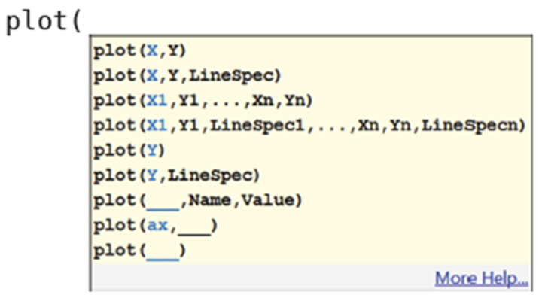
Obtaining Help in MATLAB
Help is also available “on the fly”. You can highlight any command or function name and press F1 to bring up a pop-up help window on that function.
Basic syntactic help appears automatically (after a short pause) after you enter the name of a function and an open parenthesis:
You can also bring up this syntax help by pressing Ctrl+F1. You can remove it by pressing Esc.

Slide 11
Basic Debugging in MATLAB
If you encounter run-time errors in MATLAB, the run-time stack appears in the MATLAB command window. Use the error message and stack information to learn more about the source of the error, and then either fix the issue or add error-handling code (more on error-handling in week 5: Functions and Graphing [KS1] [MR2] ). The stack information includes:
The name of the function that generated the error
The line number of the attempted operation
The sequence of function calls that led up to the execution of the function and the line at which each of these function calls occurred

Slide 12
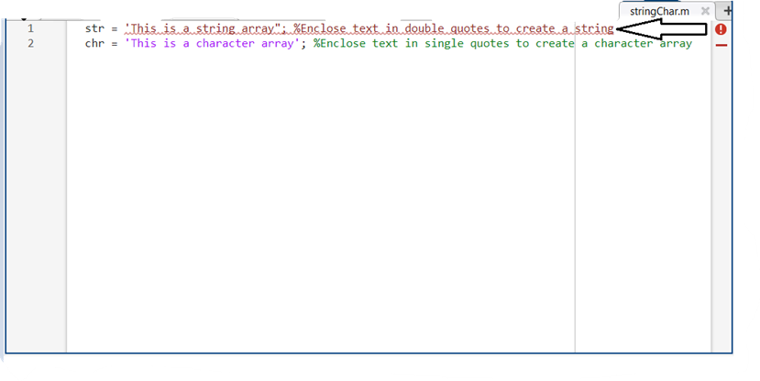
Obtaining Help in MATLAB
[KS1]Link to week 5’s live script
[MR2]Open thread since it depends on the final version in Ulwazi

Slide 13
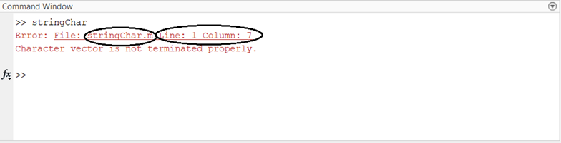
Obtaining Help in MATLAB
[KS1]Link to week 5’s live script
[MR2]Open thread since it depends on the final version in Ulwazi

Slide 14
What we've covered this week in Part 2
This week in Part 2 we learnt about:
How to access MATLAB
The MATLAB desktop
MATLAB Cheat Sheet
Obtaining help in MATLAB
Basic debugging in MATLAB

Slide 15
MATLAB Live Script
Click on the link below for this lecture’s MATLAB live Script
Week_1_Part_2_Fundamentals.mlx

